Slide 1



Teamwork Success Predictor.
ALIYU BELLO

Slide 2
Table of Content
Introduction
Problem Statement
Scope.
Background
Definitions & Terminologies.
Methodology
Dataset.
Statistical analysis.
Feature Engineering.
Machine Learning Models.
Results and Discussions
ML Performances
Conclusion
Future work

Slide 3
Problem Statement
- The research question is analyzing and predicting the success of teams in different milestone.

Slide 4
SCOPE
This research aims study the prediction using the following hypothesis.
The number of the team members significantly influences the success of the group towards a milestone.
HYPOTHESIS
This project aims to predict group success towards a milestone by analyzing relevant factors, collecting and preprocessing data, building predictive models, and understanding variable relationships impacting milestone achievement.

Slide 5

BACKGROUND
Terminologies
Definitions

Slide 6
BACKGROUND
STATISTICS.
Descriptive Statistics
Shapiro - Wilk Test
Kolmogorov – Smirnov Test
MACHINE LEARNING.
Random Forest
Decision Tree
Logistic Regression
z

Slide 7
STATISTICAL APPROACHES
Descriptive statistics: Summarizing data to reveal key features like averages and variability.
Shapiro-wilk: This is a test used to assess the normality of a data sample. It determines whether the data follows a normal distribution or not.
Kolmogrov-smirnov: is used to test the null hypothesis that a set of data comes from a normal distribution

Slide 8
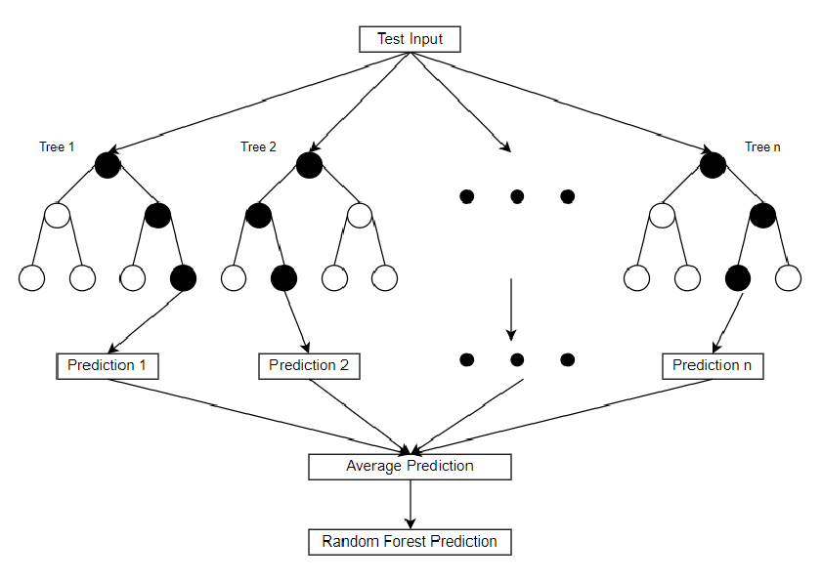
MACHINE LEARNING APPROACHES
Decision Tree: It splits data into subsets, forming branches, and assigns labels or values at the leaves.
Random Forest: This uses multiple decision trees to improve predictive accuracy and reduce overfitting by averaging their results.
Logistic Regression: This is a statistical method used for binary classification, predicting the probability of an event occurring based on input features.
Random Forest Structure

Slide 9
SYSTEM OVERVIEW

Slide 10
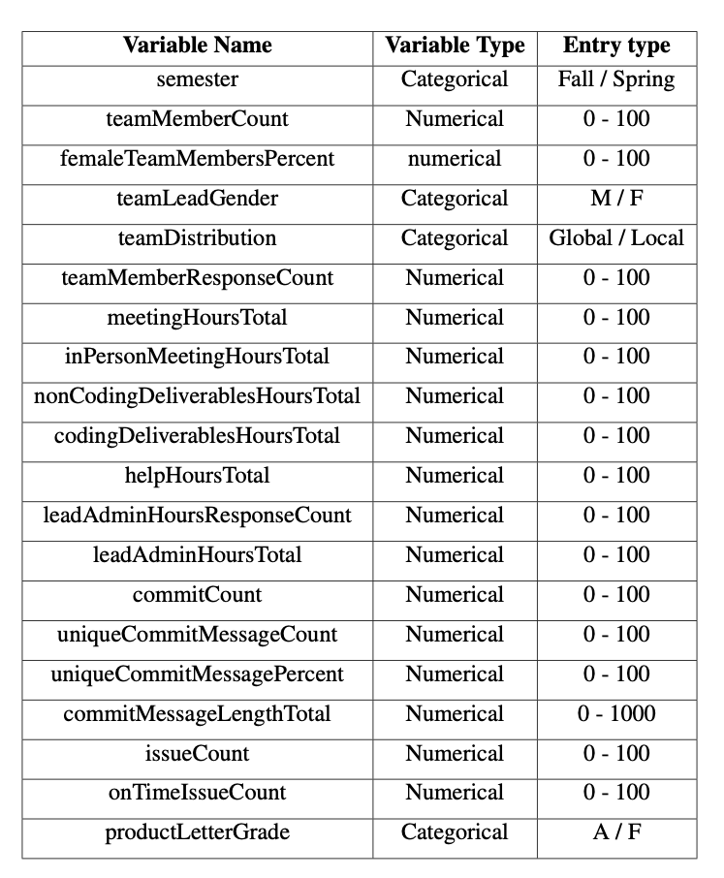
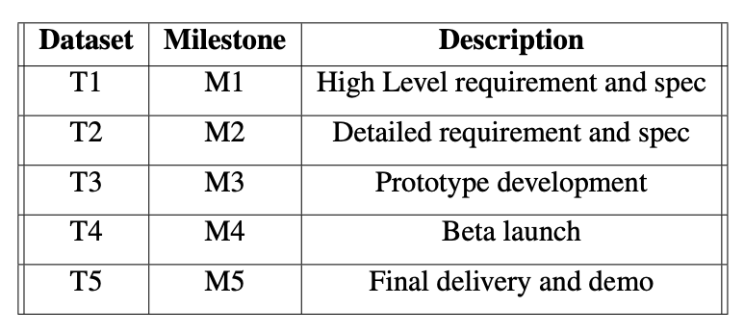
DATASETS
DATASET | T1 | T2 | T3 | T4 | T5
TOTAL OBSERVATIONS | 64 | 74 | 74 | 64 | 74
Datasets number of observations
TABLE OF VARIABLES

Slide 11

DATA CLEANING AND PREPROCESSING.
Missing values.
Number of missing variable in each dataset
Imputation: This is a powerful technique to address missing data by estimating and filling in the missing values.
Outliers.
Winsorization: This a process of replacing largest values considered outliers with the observations closest to them.
Datasets | T1 | T2 | T3 | T4 | T5
Outliers | 6 | 1 | 0 | 4 | 6

Slide 12
DATA CLEANING AND PREPROCESSING.
Duplicates
Number of missing variable in each dataset
Feature encoding
Dataset | T1 | T2 | T3 | T4 | T5
Total | 64 | 74 | 74 | 63 | 74
Distinct | 64 | 74 | 74 | 63 | 74
productLetterGrade | Encoding
A | 1
F | 0
Feature Encoding of success variable
It is observed that the total number of observations match the number of distinct records proving there are no duplicated found
This binary representation simplifies the target variable and facilitates its interpretation.

Slide 13


STATISTICAL RESULTS
DATASETS | Kolmogrov-Smirnov | Shapiro-Wilk
T1 | Not normal | Not normal
T2 | Not normal | Not normal
T3 | Not normal | Not normal
T4 | Not normal | Not normal
T5 | Not normal | Not normal
Performing the Kolmogorov-Smirnov and Shapiro-Wilk tests to assess normality in the datasets reveals that both tests indicate non-normality, suggesting that the datasets do not follow a normal distribution.
z

Slide 14
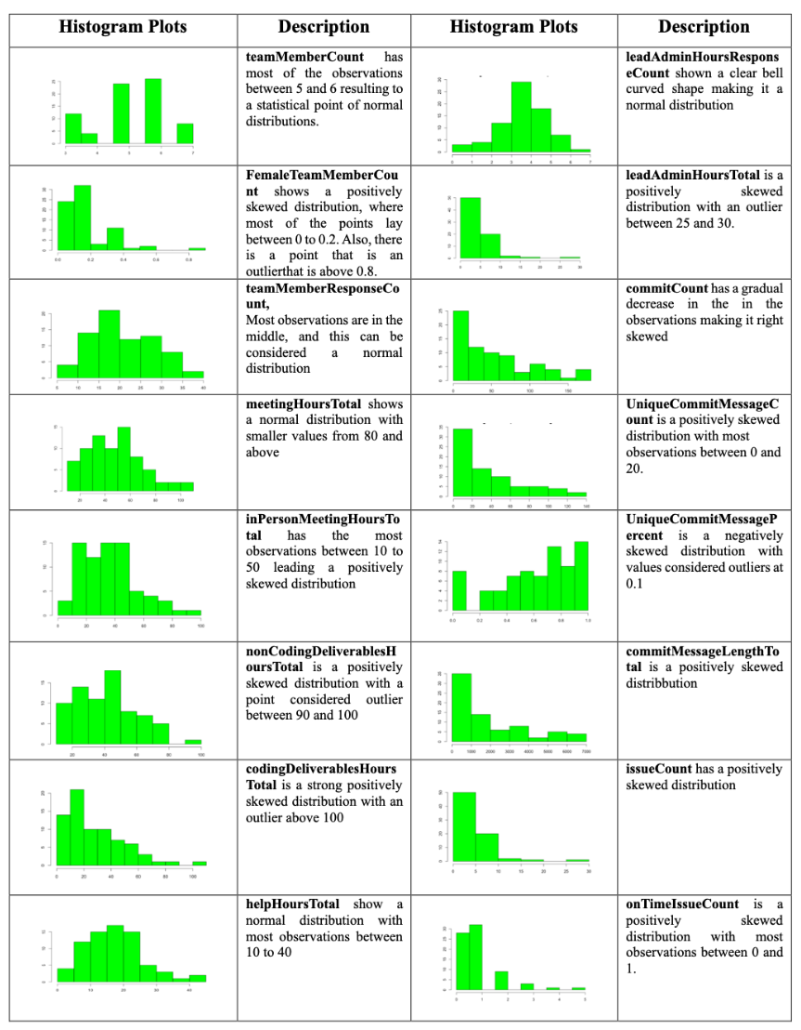
DATA VISUALIZATION
Quantitative Variables.
T1 dataset are positively skewed and normal distribution.
The histogram plots of T2 of the quantitative variables are more of normal distribution, positively skewed distributions with less number of negatively skewed distribution.
T3 and T4 datasets are mostly normally distributed.
T5 dataset has more of normal and positively skewed distribution.
z
Histograms of T2 dataset

Slide 15
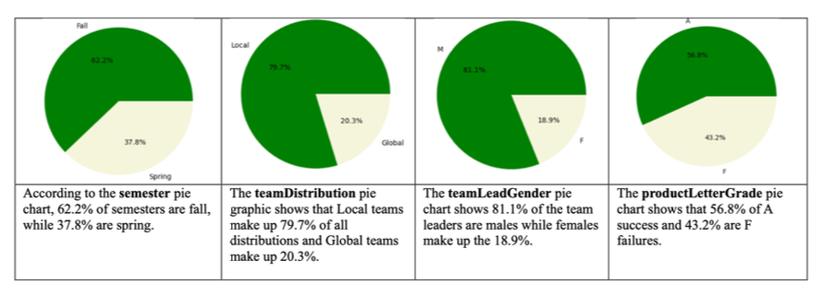
Qualitative Variables
Pie charts to visualize the categorical variables

Slide 16
RESULTS & INTERPRETATIONS.
z

Slide 17
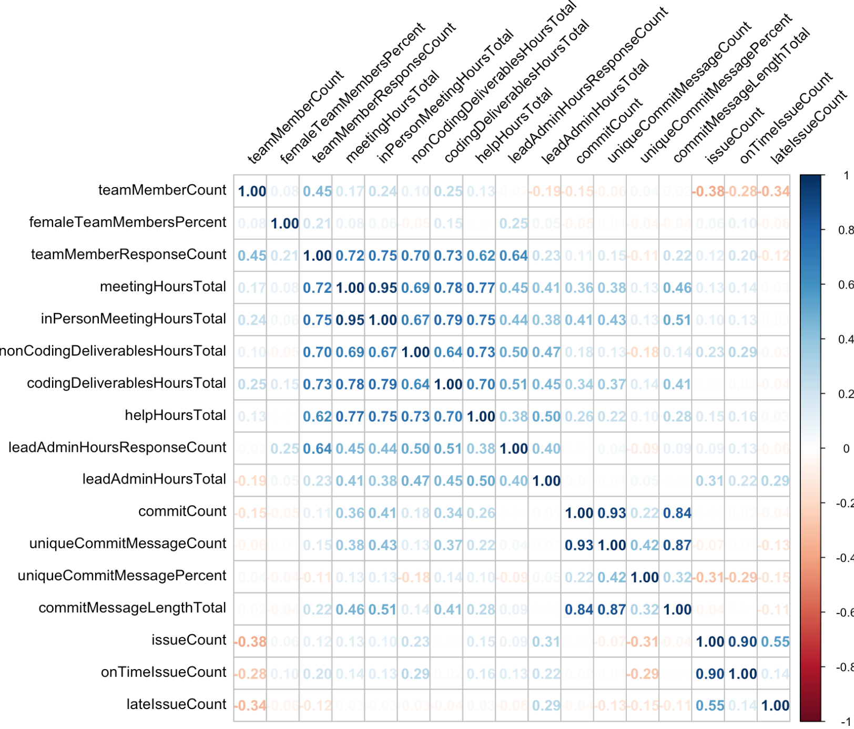
FEATURE SELECTION
Using Pearson correlation for feature selection for the dataset T3, with a threshold of 0.75, the most influential variables were filtered to 8. The variables are:
teamMemberCount, femaleTeamMembersPercent, nonCodingDeliverablesHoursTotal„ codingDeliverablesHoursTotal, helpHoursTotal,
leadAdminHoursTotal,
countCommit,
uniqueCommitMessagePercent
z

Slide 18
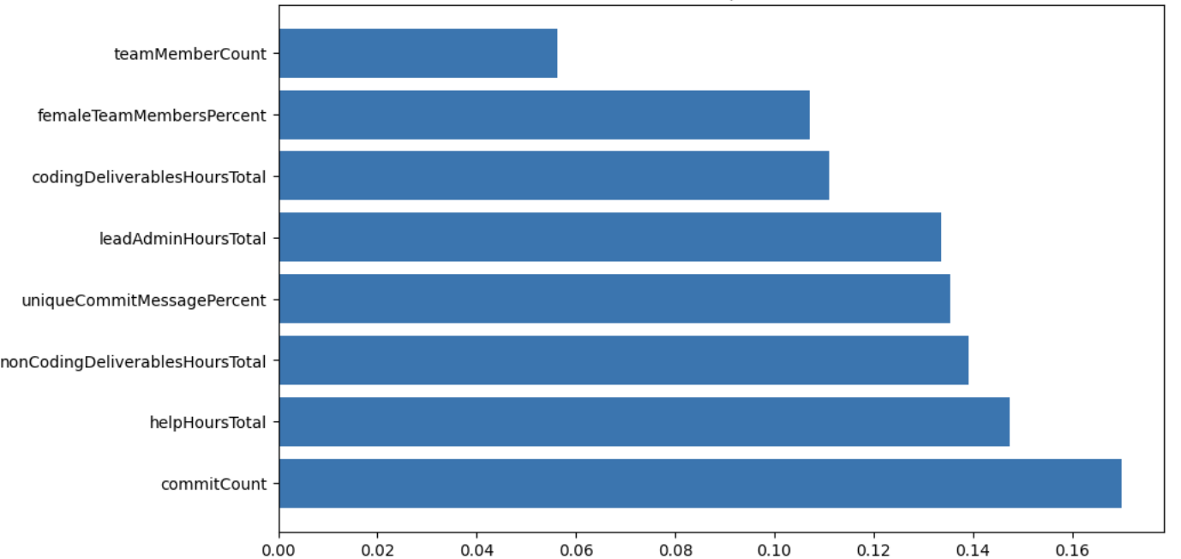
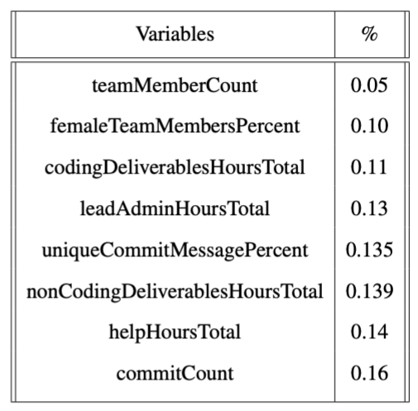
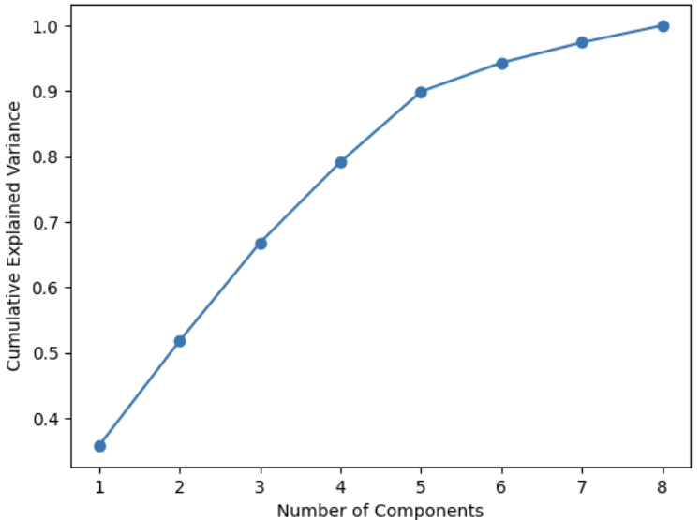
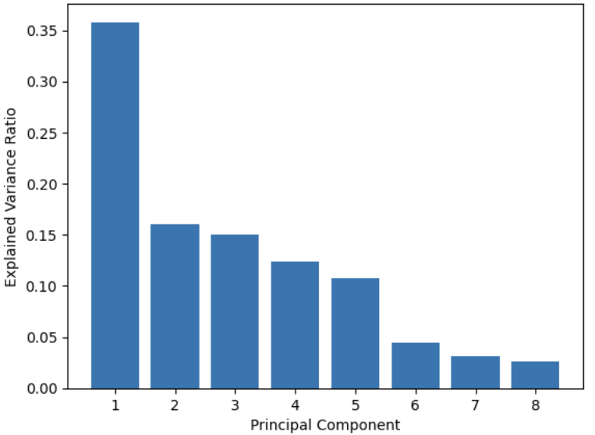
FEATURE ENGINEERING
Principal Component Analysis.
FEATURE IMPORTANCE
z
Feature importance on T3 dataset.
Explained and cumulative variance for PCA.
Feature importance measures the relevance of each feature in predicting the target variable.
In T3 dataset the PC4 shows about 79 percent, meaning the first four components can almost accurately represent the data.

Slide 19
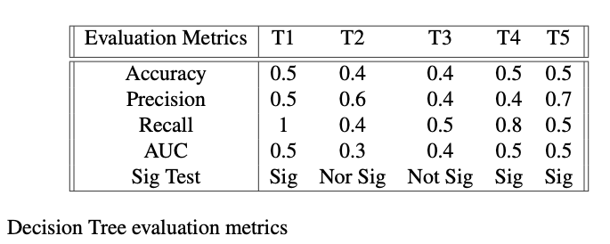
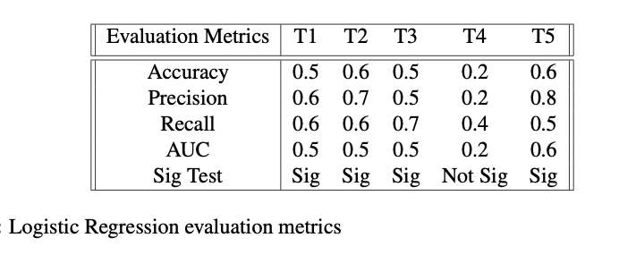
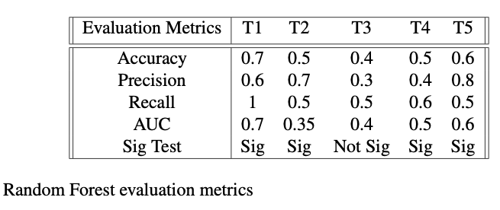
MACHINE LEARNING MODELS

Slide 20
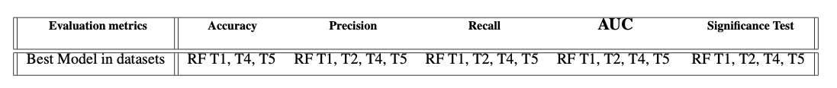
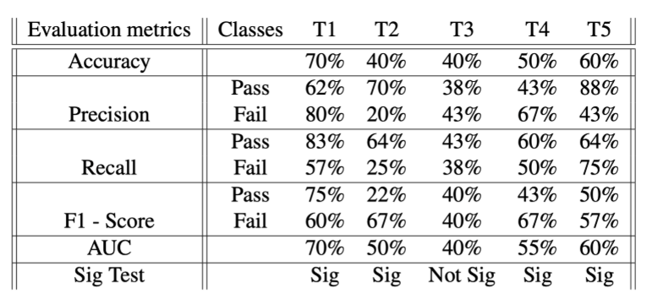

BEST MODEL: RANDOM FOREST
Grand average of the the accuracy across the 5 datasets.
= 0.52
Grand average = 52%

Slide 21
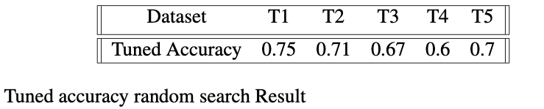
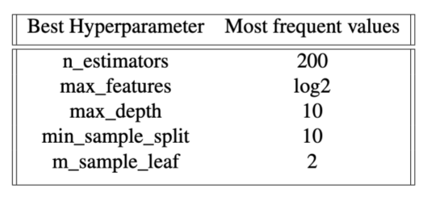

MODEL OPTIMIZATION AND TUNNING
z
Grand average of the optimized model.
Random search: random search efficiently explores the hyperparameter space to find the best combination.
= 0.68
Tuned grand average = 68%

Slide 22
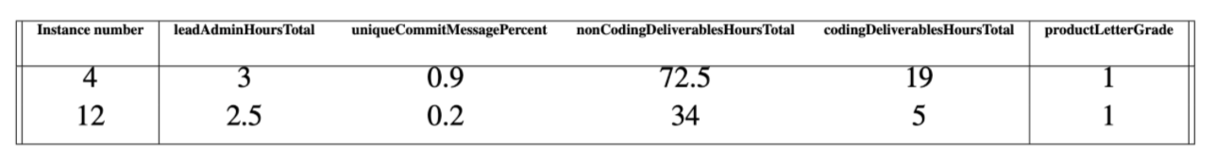
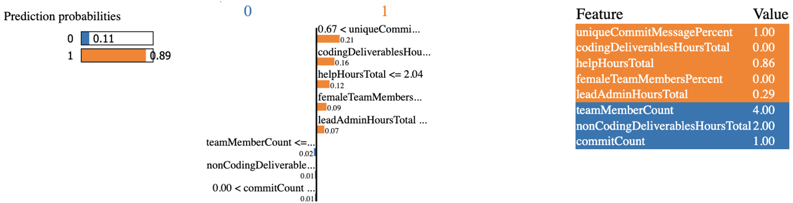
SAMPLE INSTANCES AND LIME (Local Interpretable Model-agnostic Explanations )
T2
12

Slide 23
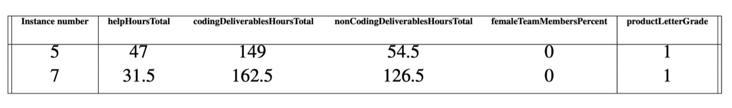
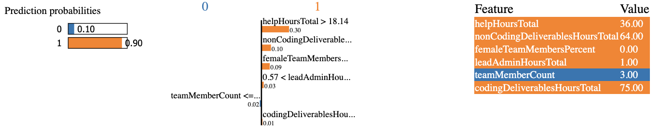
SAMPLE INSTANCES AND LIME (Local Interpretable Model-agnostic Explanations )
T5
7

Slide 24
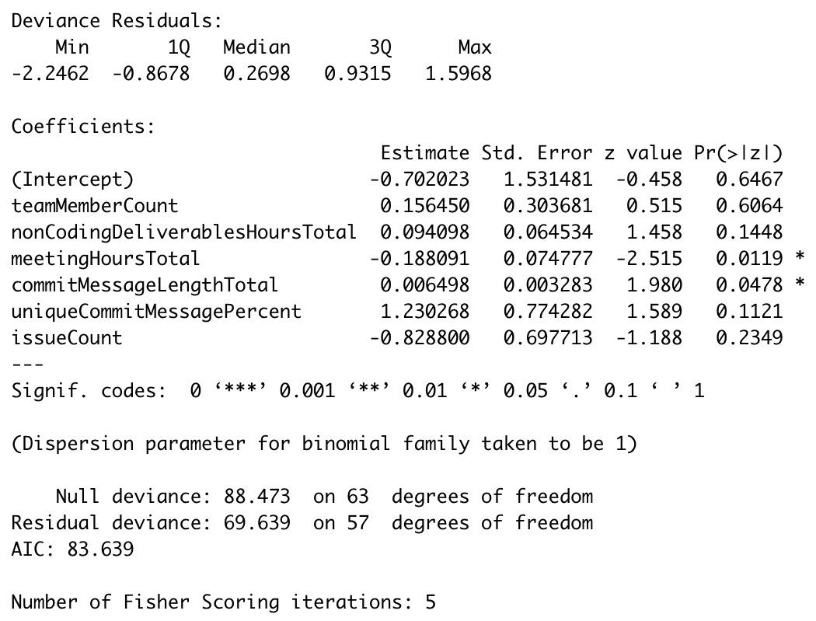
BINARY LOGISTIC REGRESSION

Slide 25
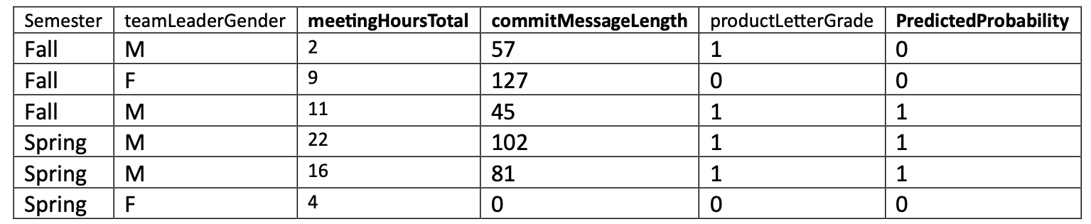
Binary Logistic Regression Interpretation
The observed pattern suggests that having a male team leader, along with higher meeting hours and commit message total, is indicative of a higher probability of team success.

Slide 26
CONCLUSION
Random Forest was the most effective model in different evaluation metrics.
The research’s findings changed the initial hypothesis, reflecting the new insights gained through the analysis process.
If codingDeliverableHoursTotal is high, the likelihood of success within that team increases significantly.
Research reflects to accuracy of the referenced paper.

